Slide 1
Nuclear Battery Using D-Clusters in Nano-materials --- plus some comments about prior H₂-Ni power cell studies
George H. Miley^{1,3}, Xiaoling. Yang¹ , Heinrich Hora²
1, Department of Nuclear, Plasma and Radiological Engineering, Univ. of Illinois, Urbana, IL
2. Dep. Theoretical Physics University of New South Wales, Sydney, Australia
3. NPL Associates, INC., Champaign, IL 61821

Slide 2
Outline
Comments re prior light water Ni studies – Patterson Cell
More recent experiments using thin-film plate type electrodes conditioned for cluster formation.
Evidence for D-clusters and comments about theory
Possible triggering methods the initiate nuclear reactions in these high density clusters
Preliminary gas loading nanoparticle experiment
Road Map and Future goal of the LENR study for Nuclear Battery applications

Slide 3
SEL Theory lead the design of our early experiments. Patterson had already used multilayer films so that work fit right in also.
Electrolytic loading used instead of gas pressure – but once loaded the mechanisms should be much the same.
Pd
+
e
n
+
e
n
+
e
n
+
e
n
+
e
n
+
e
n
+
e
n
SEL - High density electron clouds – exists between metals of different Fermi energy, providing the necessary screening
Ni
e
e
e
e
e
e
e
+
e
n
+
e
n
+
e
n
+
e
n
+
e
n
+
e
n
+
e
n
Pd
e
e
e
e
e
e
e
+
e
n
+
e
n
+
e
n
+
e
n
+
e
n
+
e
n
+
e
n
Ni
e
e
e
e
e
e
e
e
e
e
e
e
e
e
e
+
n
+
n
+
n
+
n
+
n
+
n
+
n
Pd
e
e
e
e
e
e
e
+
n
Substrate
Substrate
Swimming Electron Layer (SEL) Theory
e
Zoom-in View
e
e
e
+
n
n
+
+
n
+
n
e
e
e

Slide 4
Comments – Patterson Cell Studies – Light water- Ni system
Key point – identification of reaction products and
connection to heat release.
[Jim Patterson and his grandson, Jim Redding, founded CETI to develop this power cell. Various demonstrations of a 1-kW unit were done and Jim appeared on the “today” TV show. They had a contract with a hot water heater company as a first “application”. Avoided energy conversion integration problems. His grandson’s sudden death, followed several years later by Jim’s ended their efforts. But the results are documented and I was involved in the work as reported here.

Slide 5

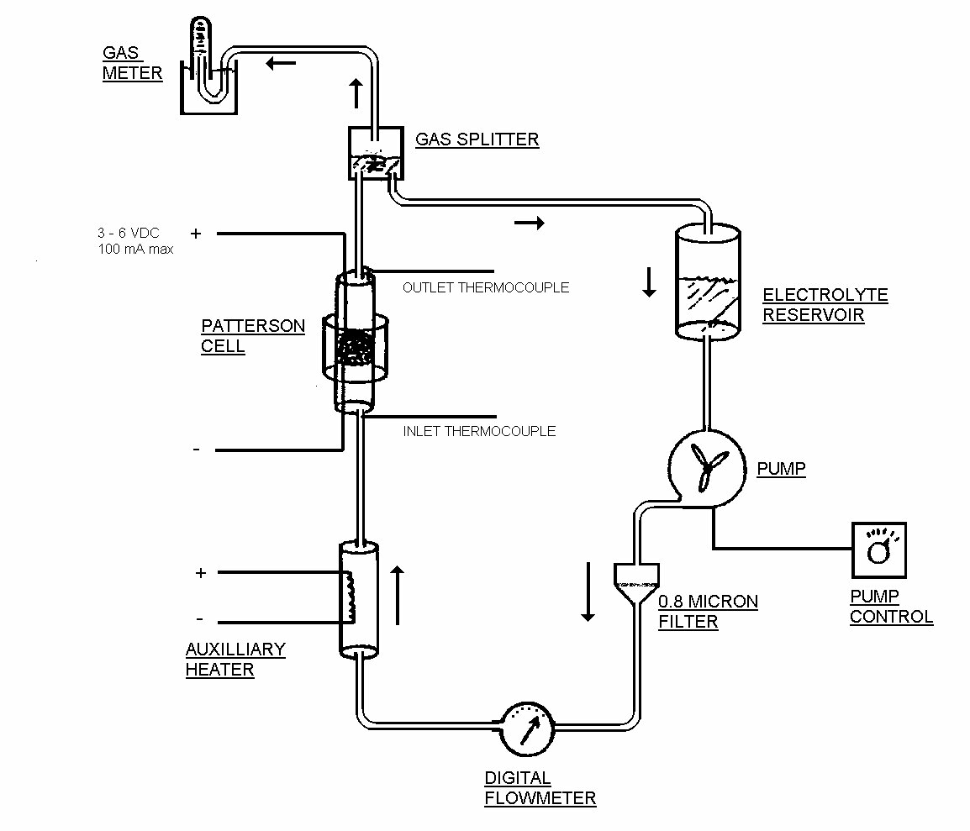

Process Flow Sheet of Electrolysis
E
X
P
E
R
I
M
E
N
T
S

Slide 6
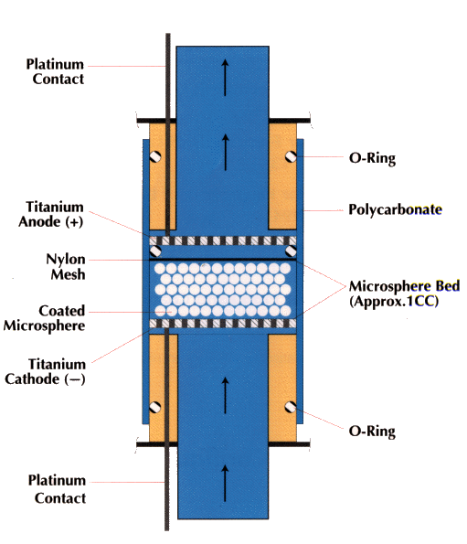
Patterson Power Cell™
Design
E
X
P
E
R
I
M
E
N
T
S

Slide 7
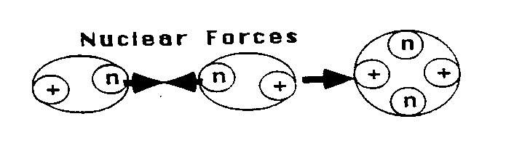
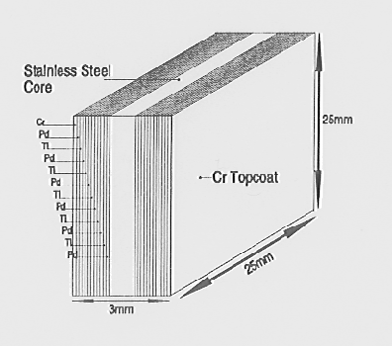
SEL Theory and Experiments to Design Multilayer Thin-film Electrodes
B
A
C
K
G
R
O
U
N
D
Fusion of two nuclei, shielded by the swimming electron layer
Multilayer thin-film electrode design with alternating layers of Pd & Ni or Ti with a topcoat of Cr

Slide 8
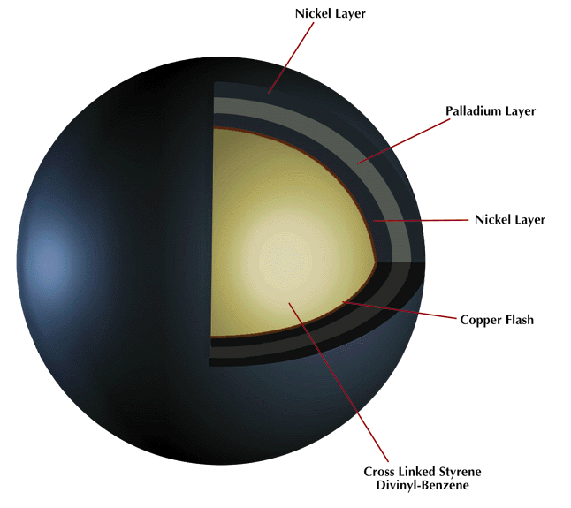
Microsphere Design
B
A
C
K
G
R
O
U
N
D
CETI uses an electrolytic coating process to coat metals on the microspheres. My sputter coating technique achieves better control of coating thickness and sharp interfaces compared to the electrolytic process. – however the ecess heat is cut by an order of magnitude!

Slide 9
Excess heats of 1-2 kW were consistently produced with these cells. How? Light water and Ni should not produce a reaction!! The next slides explain my search for an answer. I propose that similar studies should be done for rossi’s cell.

Slide 10
Rational for Combined SIMS-NAA
Analysis for a large number of isotopes needed.
NAA is time consuming and was limited to nine elements with appropriate cross sections where reference standards were available.
SIMS, with ultra low detection limits, could detect all isotopes rapidly, but it provides relative isotope concentrations and abundance ratios are more precisely than it does absolute concentrations.
Thus the SIMS concentration values were normalized to the more accurate NAA results.

Slide 11
SIMS Analysis
Initial runs done in low resolution.
conditions (off-set voltage, entrance/exit slits, field aperture, energy slit) optimized to minimize interferences.
Isotopes of interest with possible interference then selected for high resolution.
Error analysis considers interference effects, fractionalization, non-uniformity, small sample numbers.

Slide 12
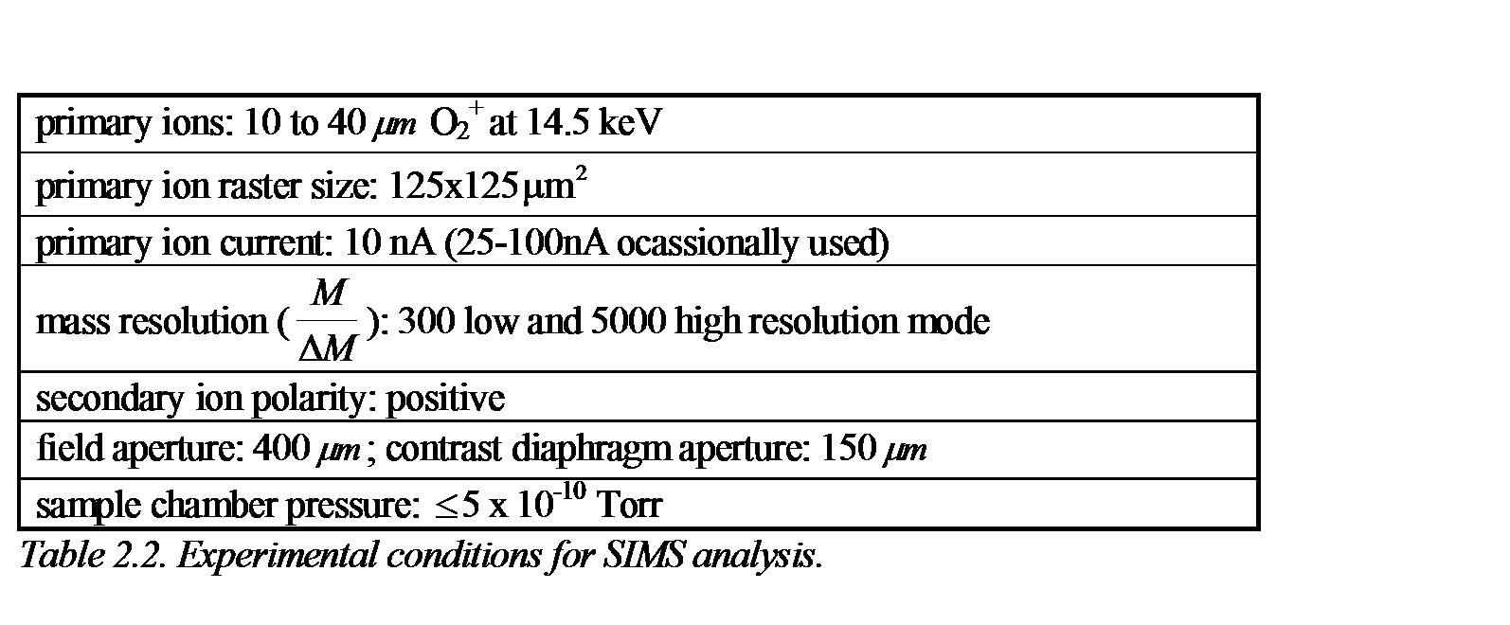
Operating Characteristics of Dual Focusing SIMS (CAMECA IMS 5f)

Slide 13
Quantification of Isotopes by Combined SIMS & NAA
D
I
A
G
N
O
S
T
I
C
S
Mass Spectrum of a sample, indicates relative concentrations of species. Compare spectrum before and after electrolysis.

Slide 14
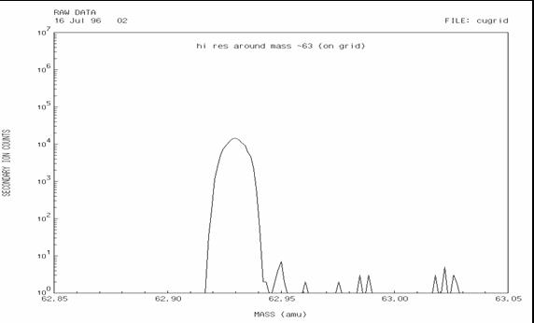
High-Resolution Mass Spectrum for 63Cu Isotope Identification. The Mass Range Analyzed is 62.85 to 63.05 amu, with a Total of 150 Channels, Going of ~4625.

Slide 15
Parameters for NAA Runs

Slide 16
NAA Detection System and Analysis
The gamma-ray detector system had: a liquid N2 cooled high purity germanium (HPGe) crystal detector with an 18% relative efficiency (1.9-keV resolution for the 1332-keV photopeak of 60Co); A large NaI(T1) crystal ring detector outside the main detector; An ORTEC ADCAM PC-based mutichannel analyzer.
Compton suppression was used to further minimize the background.
A reference standard method was used to determine the comparative method for measuring the concentration of the element(s). This used simultaneous irradiation and -counting of a prepared NIST sample (one standard for each element to be estimated) along with the test sample.
The spectrum data was processed using the Neutron Activation Data Analysis (NADA) code. The output included concentration values in %, ppm, g or ppb units and associated errors.
Flux variations, high deadtime corrections, counting geometry, spectral and nuclear interference, as well as uranium fission interference were accounted for in analysis.

Slide 17
Typical NAA Spectrum
D
I
A
G
N
O
S
T
I
C
S
Gamma spectrum with sample chart of concentrations. The spectrum of gamma-rays is used to identify and quantify the element that emitted it, using a reference sample in the same run.

Slide 18
NAA Results Before and After Run Shows Large Increase in Nine Elements Selected

Slide 19
Results
Large increase in number of isotopes found after a run.
Four regions (“peaks”) of mass number have higher concentrations.
Concentrations appear to be much larger than possible due to impurities in cell.
Concentrations divided by run time defined as reaction production rate.
Isotopes in 39 elements show significant deviations from natural abundance.

Slide 20
Isotope Production Rates Show Large Yields of Key Elements and 4 “peak” Pattern

Slide 21
39 Elements Show Significant Isotope Shifts from Natural Abundance

Slide 22
Comparison of Ti Run with Prior Data for Other Coatings Such as Ni

Slide 23
Conclusions and relation to Rossi
To summarize, this research developed a unique SIMS-NAA analysis technique for studies of isotopes in thin films after undergoing electrolysis in a packed bed cell.
This technique combines the broad coverage of elements with SIMS and the absolute precision capability of NAA.
This technique should be applicable to a broad range of analysis problems of interest.
I would suggest that this technique be applied to the Rossi cell
A key issue – are these product & associated reactions responsible for the excess heat? As shown in later slides, the answer seems to be that these reactions are a major contributor.

Slide 24
Other lessons learned
Ideal smoothed coated films not as good as “rough” ones. Implied local defects played a role. Reaction products highly concentrated near interfaces, perhaps due to anchoring of dislocations there.

Slide 25
Outline
Comments re prior light water Ni studies – Patterson Cell
More recent experiments using thin-film plate type electrodes conditioned for cluster formation.
Evidence for D-clusters and comments about theory
Possible triggering methods the initiate nuclear reactions in these high density clusters
Preliminary gas loading nanoparticle experiment
Road Map and Future goal of the LENR study for Nuclear Battery applications

Slide 26

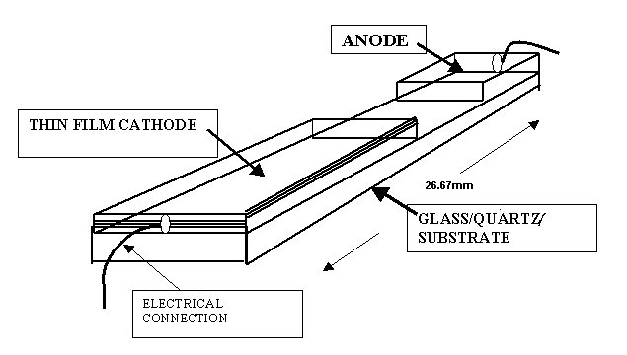
SEL Theory Lead to Multilayer Thin-film electrodes- went to flat plates vs. beads to obtain better control over manufacturing film & defects
Pt
Pt
Pd/Ni
Multilayer thin-film electrode design with alternating layers of Pd & Ni.
Planar A-K structure used to maximize H2 concentration via electrodiffusion
Concept
Notes:
26

Slide 27
Results #1 -- Calorimetry Shows During Electrolysis Thin-Film Electrodes Produce Significant Excess Heat
Heat measurement for two layers electrode: 8000Å Pd and 1000Å Ni on Alumina.
P_{therm}: Measured Heat power;
P*=I (U-U₀): Input electrical Power
Notes:
U0 water dissociation potential between Pd/Ni and Pt electrodes

Slide 28
Results #2 -- Transmutation Products
Reaction Product Yield vs. Mass Curve
Notes:
Neutron activation analysis (NAA) Secondary ion mass spectrometry (SIMS) and EDX were used for products measurement. a variety of reaction products occur with masses lying well below and above that of the base electrode metal (Ni and Pd)
Widom and Larsen claimed that the theoretical transmutation calculations reasonably well match the Miley & Patterson result

Slide 29
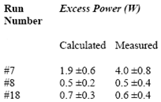
Computation of excess power from reaction product measurements gives order of magnitude agreement with measurement.
Equation
Results from Energy Balance Calculations for Three earlier Thin-Film experiments.
All experiments used Li₂SO₄ in H₂O for the electrolyte and thin-film Ni coated cathodes.

Slide 30
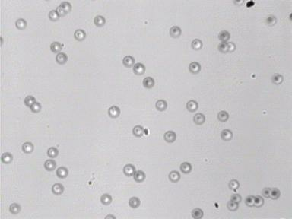
Results #3 -- MeV charged-particles Alpha-Particles and Protons
High-energy charged particles: 1.5 - 1.7 MeV protons and 11-16 MeV alphas.
After background subtracting
Tracks in CR-39 from 12.0 MeV α-particles; image area S= 0.2x0.2 mm, (X 700)
Notes:
30
Recording Time?

Slide 31
Outline
Comments re prior light water Ni studies – Patterson Cell
More recent experiments using thin-film plate type electrodes conditioned for cluster formation.
Evidence for D-clusters and comments about theory
Possible triggering methods the initiate nuclear reactions in these high density clusters
Preliminary gas loading nanoparticle experiment
Road Map and Future goal of the LENR study for Nuclear Battery applications

Slide 32
Comment -
Propose search for charged particle and soft x-ray emission from Rossi

Slide 33
Our Recent Dislocation-Loop-Cluster Studies
Pd thin foil – 12 µm
Loading and unloading deuterium/hydrogen was done by cyclically cathodizing and anodizing Pd foil → dislocation loop and cluster formation
PdO
Pd
PdO

Slide 34
Temperature Programmed Desorption (TPD) Experiment
Binding Energy calculation – close to the binding energy between hydrogen and dislocations
After the loading foil was annealed under 300 ºC for 2 hr, the temperature was ramped from 20 ºC to 800 ºC at 9 ºC /min.

Slide 35
Experimental Magnetic Moment Measurements of Pd:H sample show superconducting state
The magnetic moment of H₂- cycled PdHx samples in the temperature range of 2 ≤ T < 50 K is significantly lower than M(T) for the original Pd/PdO.
A. Lipson, B.I. Heuser, C. Castano, G.H. Miley, B. Lyakov & A. Mitin, Physical Review B 72, 212507/1-6 (2005):

Slide 36
Another proof of clusters – petawatt laser beam extraction
We are funded to do experiments at LANL to study the extraction of MeV D+ ions from these clusters using the TRIDENT petawatt laser

Slide 37
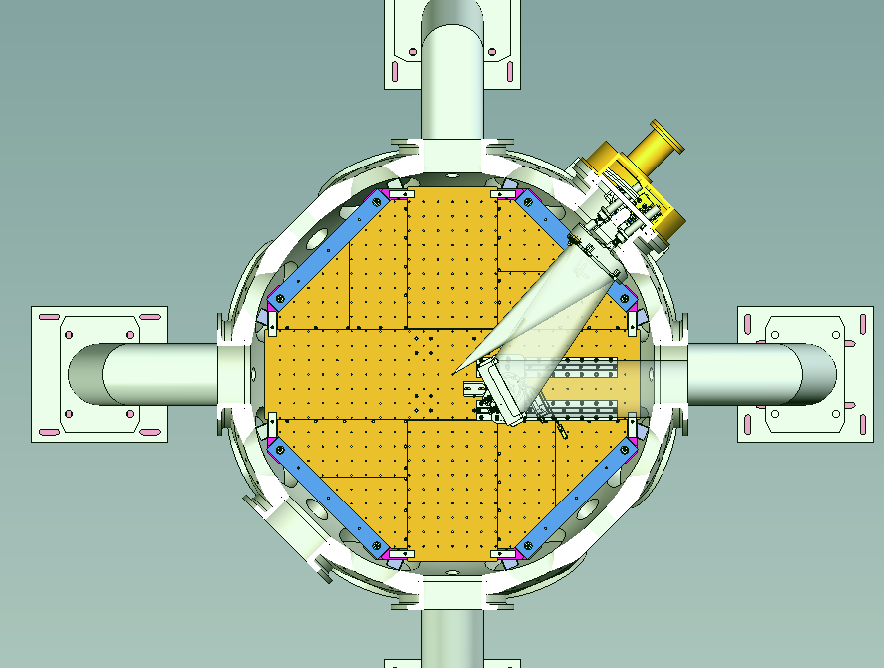



Deuteron Acceleration Experiment In LANL
Neutron Bubble
Detectors
(thermal or >10 MeV)
Film Detector /
Nuclear Activation
Stack
Vacuum Vessel Supports
Ion Beams
Laser Beam
Target
Thomson Parabola Ion Energy Analyzer
Vacuum Vessel
U N C L A S S I F I E D
Operated by Los Alamos National Security, LLC for the U.S. Department of Energy’s NNSA

Slide 38
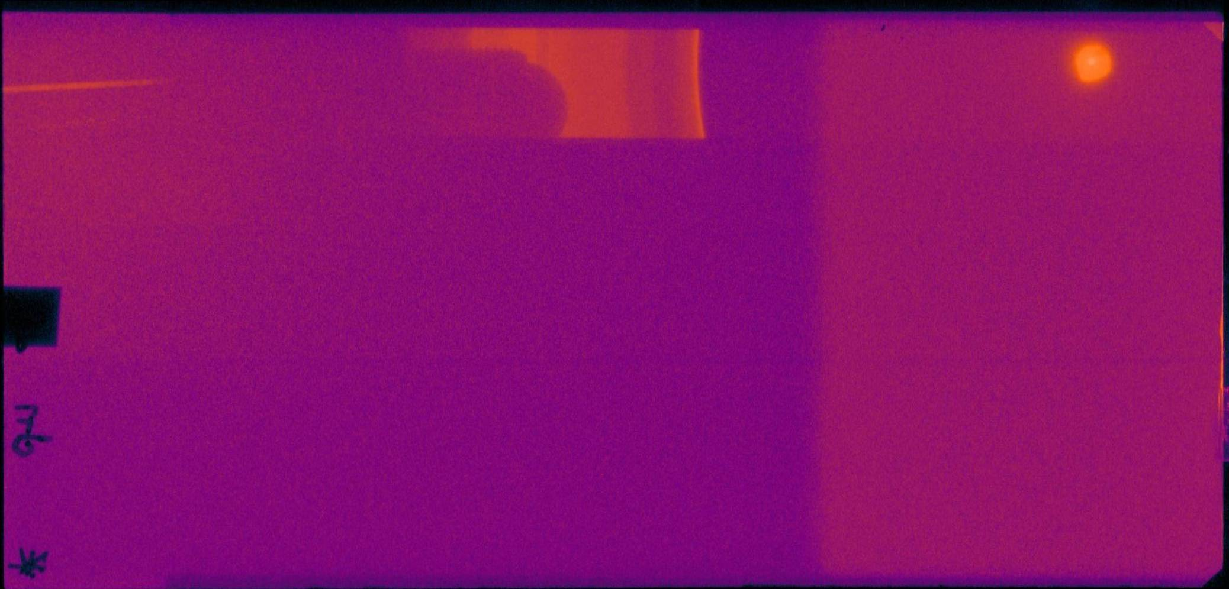
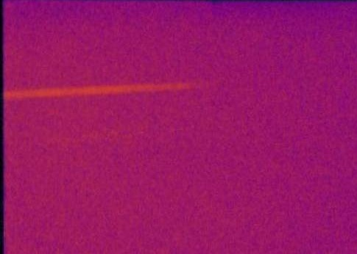
Ion Trace of PdD Separated by Thompson Parabola WITH Ti Filter
Laser Energy in 81.9 J out 67.1
Zoom In View
P
D⁺
Image Plate

Slide 39
Comments –TRIDENT results
Demonstrate acceleration from clusters
Flux and energy depressed, probably by impurity protons (and C?)
Next experimental campaign
  Continue to improved cluster packing fraction
  Reduce contamination (p and C).
  Obtain more insight from ongoing supporting simulation studies.

Slide 40
Conclusion: High density deuterium cluster formation (Pseudo Bose-Einstein Condensation) at room temperature occurs and is fundamental as a way to create nuclear reactive sites for LENR

Slide 41
Theory
Zoom-in View
Bose-Einstein Condensation in a sub-nano scale
Pd
Pd
+
e
n
+
e
n
+
e
n
+
e
n
+
e
n
+
e
n
+
e
n
Ni
e
e
e
e
e
D
D
D
D
D
e
e
Ni
+
e
n
+
e
n
+
e
n
+
e
n
+
e
n
+
e
n
+
e
n
D
D
D
D
D
Pd
e
e
e
e
e
e
e
+
e
n
+
e
n
+
e
n
+
e
n
+
e
n
+
e
n
+
e
n
D
D
D
D
D
Ni
e
e
e
e
e
e
e
e
e
e
e
e
e
e
e
D
D
D
D
D
+
n
+
n
+
n
+
n
+
n
+
n
+
n
Pd
e
e
e
e
e
e
e
+
n
Substrate
Substrate
Substrate
Swimming Electron Layer (SEL) Theory
e
Zoom-in View
Anchored D Loops
Yeong E. Kim, Theory of Bose–Einstein condensation mechanism for deuteron-induced nuclear reactions in micro/nano-scale metal grains and particles, Naturwissenschaften, 96(7):803-11 (2009)
e
e
e
+
n
n
+
+
n
+
n
e
e
e

Slide 42
Outline
Comments re prior light water Ni studies – Patterson Cell
More recent experiments using thin-film plate type electrodes conditioned for cluster formation.
Evidence for D-clusters and comments about theory
Possible triggering methods the initiate nuclear reactions in these high density clusters
Preliminary gas loading nanoparticle experiment
Road Map and Future goal of the LENR study for Nuclear Battery applications

Slide 43
Recent work is designed to extend the thin-film technique to nanoparticles.
For applications this will allow high temperatures with gas loading – i.e. improved performance when energy conversion is integrated into the cell

Slide 44
Cluster Formation in Nanomaterials
Clusters mainly forms at the places that is close to the material surface.
Nanomaterials have more surface area, thus have good ability to form abundant clusters
Pd
Almost no clusters
Clusters zoom in
Bulk material
Nanoparticles

Slide 45
Triggering The Reaction
Electrolysis (pulse or ramp)
Gas loading (pulse pressure)
  Smaller heat capacity
  Higher temperature change as compared with an electrolysis system.
  Without the constraint of being limited by the boiling temperature of the fluid
Glow Discharge (bombardment)
Low energy laser; ultrasound; em radiation,…..

Slide 46
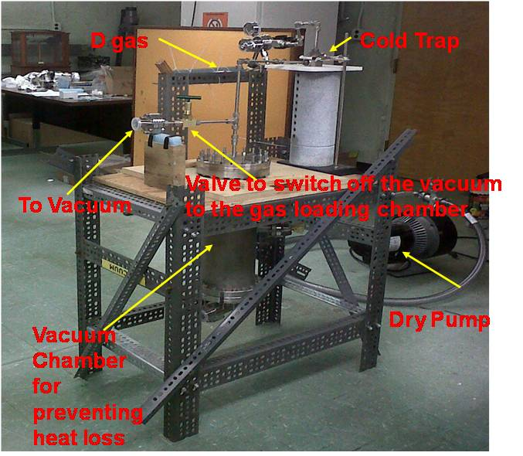
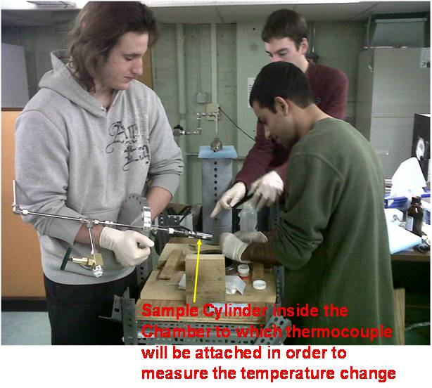
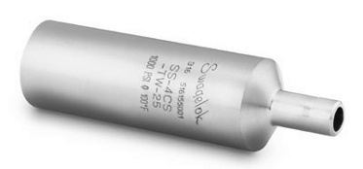
Our Gas Loading System
2.2cm inner diameter
25cm³ total volume

Slide 47
Inside View

Slide 48
Preliminary Excess Heat Measurement Using Our Gas Loading Calorimetry System
High purity (99.999%) D₂ gas at 60 psi
20g ZrO₂Pd₃₅ nano powder
Gas loaded under room temperature and then unloaded.
exothermal energy from chemical reaction --- 690J
Calculation: Energy = ∆H×M_{D2}
∆H = -35,100J per mole of D₂ for the formation of PdD_{x} for x < 0.6;
M_{D2} is the total moles of D2 that combined with Pd
Actual measured energy -- 1479J
Calculation: Energy =ΔT(M_{chamber} S_{chamber} + M_{powder}S_{powder})
Δ T is temperature change, M is mass, and S is the specific heat

Slide 49
The result show was from June – we have continued this work but I do not have slides to show of this work in progress
Most effort has been to develop improved nanoparticles by comparing and down selecting a series of triple alloys.

Slide 50
Summary – gas loading
Experimental evidence confirms cluster formation in dislocation loops.
Methods to fabricate high loop density under study.
Further experiments should consider nanomaterials of different size and composition

Slide 51
Outline
Comments re prior light water Ni studies – Patterson Cell
More recent experiments using thin-film plate type electrodes conditioned for cluster formation.
Evidence for D-clusters and comments about theory
Possible triggering methods the initiate nuclear reactions in these high density clusters
Preliminary gas loading nanoparticle experiment
Road Map and Future goal of the LENR study for Nuclear Battery applications

Slide 52
Road Map to a Prototype LENR Unit Development

Slide 53
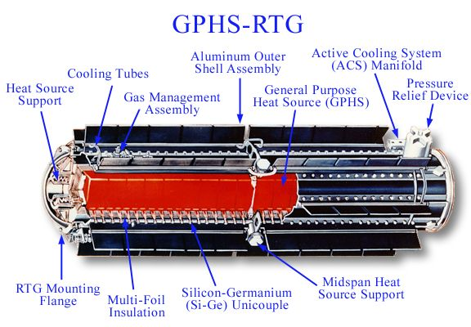
The LENR power cell is well suited for use as a “New Type RTG” with the LENR cell replacing the PU238
Drawing of an GPHS-RTG that are used for Galileo, Ulysses, Cassini-Huygens and New Horizons space probes.
source:http://saturn.jpl.nasa.gov/spacecraft/safety.cfm

Slide 54
Many issues remain
What is the energy producing reaction and can it be optimized?
Alternate metals (reduce costs, improve operation, etc.
Alternate gaseous fuel? H2,D2, Tritium, D-T, etc?
Are there any radioactive products?
Any emissions? Soft x-rays, charged particles, gammas?
Lifetime issues – radiation damage to the electrode materials? Effect of reaction production structure and also on stopping later reactions?
Burn up of fuel? Burn up of fuel in local sites?
Is there any direct energy conversion possibility?
If heat, what is the optimum temperate-conversion method.
Control methods?
……………..

Slide 55
Acknowledgment
This work is supported by the New York Community Trust and NPL Associate Inc.
Recent experimental work was under the assistance of Monish Singh, Erik Ziehm, Chi Gyun Kim, Ittinop Dumnernchanvanit, and Seth Hartman.

Slide 56
For further information, contact
George H. Miley ghmiley@uiuc.edu
217-3333772
Xiaoling Yang xlyang@illinois.edu

