Slide 1
Application of Redox-active Polymers (RAPs) for energy Storage in Redox-Flow Batteries
Zirui Wang
December 4th, 2023
NPRE 498, Final Presentation

Slide 2
Short Personal Bio
2nd year graduate student in Materials Science and Engineering
BS 2018, Materials Science and Engineering, University of Illinois, Urbana-Champaign
Currently working with in the research group of Prof. Joaquín Rodríguez-López
Energy storage in batteries, fuel cells, etc.
High-throughput/Automated electrochemical methods
Electrochemical CO₂ capture
Molecular electrocatalysis
Electrochemical cancer detection/treatment
Check out our group website for more works! (http://faculty.scs.illinois.edu/rodriguez-lopez/research.html)
1

Slide 3
Outline
Outline Introduction Results and Discussion Summary
Introduction:
Why batteries are important
Theory, setup, and benefits of redox-flow batteries (RFBs)
Traditional RFBs
Problems with traditional RFBs
Results and discussion
Redox-active polymers (RAPs): introduction
The use of conductive polymers in RFBs
The use of polymers with redox-active pendants in RFBs
Summary:
Current state-of-art
Future directions
2

Slide 4
Global Warming, As We All Know
Outline Introduction Results and Discussion Summary
Global warming forces human to find alternatives to fossil fuels
Cleaner energy conversion methods as well as energy storage becomes overly important
Wind power
Solar power
Batteries and fuel cells
https://theglobalobservatory.org/2021/12/new-climate-data-visualizations-2021/
3

Slide 5
Why Batteries?
Outline Introduction Results and Discussion Summary
Replenishable
Typically, only electricity is required to recharge a battery
Versatile
Can be used in lots of platforms ranging from portable electronic devices to spacecrafts
Fast energy conversion
Negligible intermittence
Good energy density and specific power
Minimal carbon emission
4

Slide 6
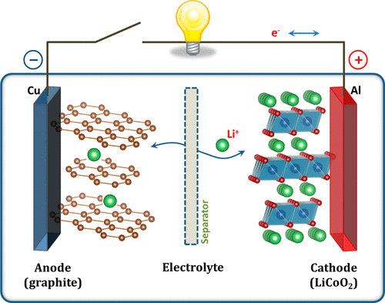
Electrochemical Energy Storage
Outline Introduction Results and Discussion Summary
The energy cost of chemical reactions is described by the Gibbs free energy ($∆G$)
The accessible electrical energy from a heterogenous electron transfer reaction ($A+{ne}^{−}⟷B$) is described by the following equation:
$$E=−\frac{∆G}{nF}$$
$∆G$: Free energy difference between B and A
n: number of electrons transferred
F: Faraday’s constant (96485 C/mol)
Electricity can be obtained from spontaneous chemical reactions ($∆G<0$)
Example: Lithium-ion battery
Cathode: $CoO_{2}+Li^{+}+e^{−}⇌LiCoO_{2}$
Anode: $LiC_{6}⇌C_{6}+Li^{+}+e^{−}$
Overall: $LiC_{6}+CoO_{2}⇌LiCoO_{2}+C_{6}$
Typical cell voltage: 3.7 V
Journal of the American Chemical Society 2013, 135 (4), 1167–1176
5

Slide 7
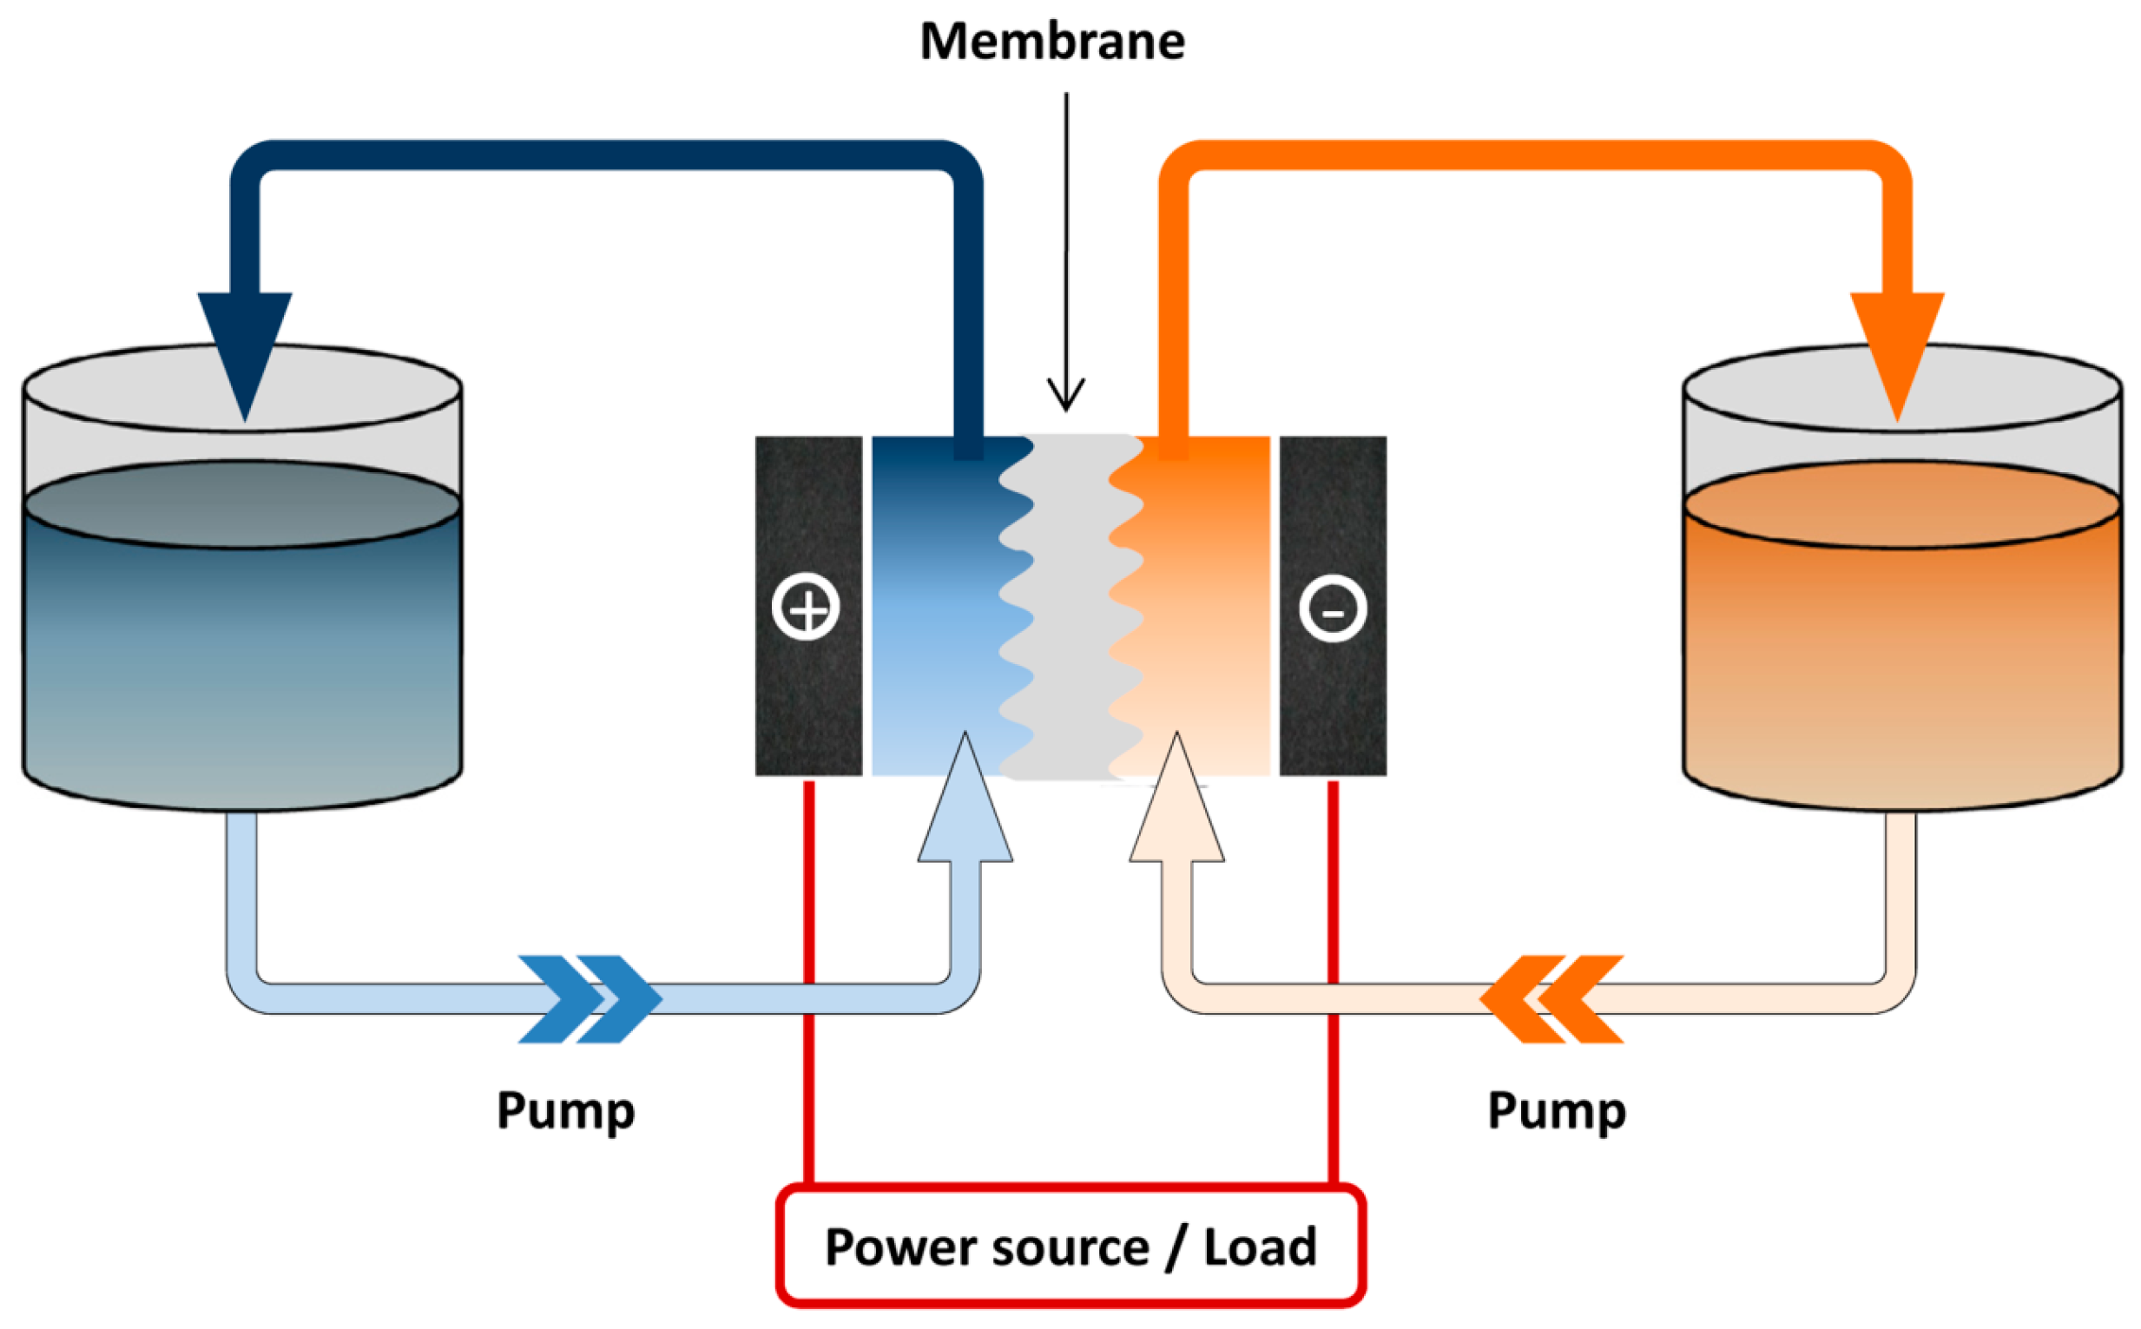
Redox-flow Batteries (RFBs)
Outline Introduction Results and Discussion Summary
RFBs have two tanks of electrolyte
Electrolytes are pumped into the electrochemical cell in the middle
Electricity is obtained via spontaneous reactions
Simply refilling the electrolyte tanks to recharge the RFB
No limit on capacity
Traditional RFB:
Vanadium-based
Anode: $VO^{2+}+H_{2}O⇌VO_{2}^{+}+2H^{+}+e^{−}$
Cathode: $V^{3+}+e^{−}⇌V^{2+}$
Total: $V^{3+}+VO^{2+}+H_{2}O$ $⇌VO_{2}^{+}+2H^{+}+V^{2+}$
Problems:
Low energy density due to the presence of tanks
Low cell voltage
Not cost effective due to vanadium price
Catholyte
Anolyte
Can these problems be solved?
Molecules 2015, 20, 11, 20499-20517
6

Slide 8
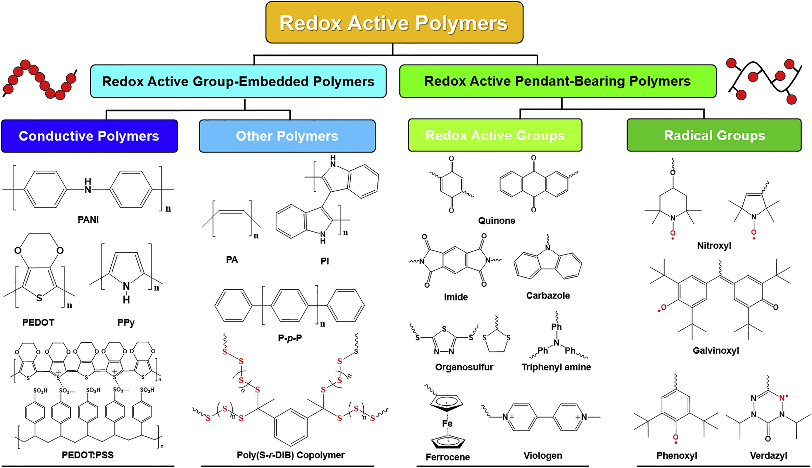
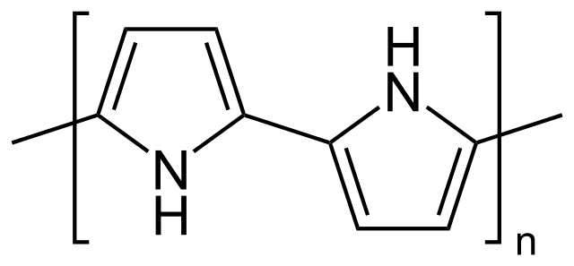
Redox-active Polymers (RAPs) As New Electrolytes for Redox-flow Batteries
Outline Introduction Results and Discussion Summary
A polymer is a large molecule (macromolecule) that consists of a large number of repeating units.
Redox-active polymers (RAPs) can transfer electrons, which means they can be oxidized (lose electrons) or reduced (accept electrons)
Two types of RAPs:
Redox-active group embedded polymers
Redox-active pendant-bearing polymers
https://en.wikipedia.org/wiki/Polypyrrole
Joule 2017, 1 (4), 739–768
7

Slide 9
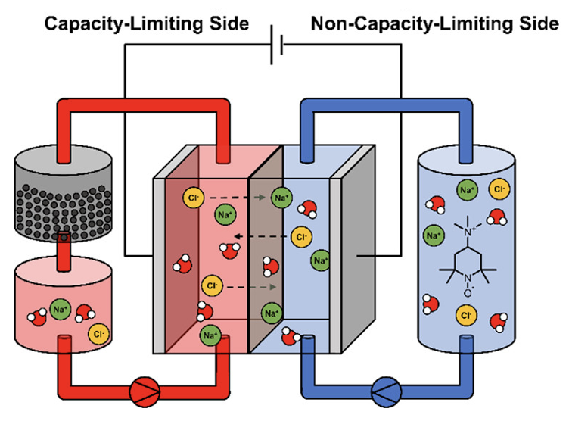
Redox-Active Group Embedded Polymers and Redox Targeting
Outline Introduction Results and Discussion Summary
The repeating units of redox-active group embedded polymers can be oxidized or reduced.
Once a single unit is oxidized/reduced, the charge (electron/hole) will propagate throughout the polymer chain, so redox-active group embedded polymers are conductive.
Conductive polymer can mediate the charges between the reduced (Red) and the oxidized (Ox) form of the electrolyte via chemical reactions.
Example:
The oxidized form of the catholyte gets reduced and is pumped into the tank that contains conductive polymer -> Conductive polymer reacts with the reduced form of the catholyte, taking away the charge to power the load as well as regenerating the original form of the catholyte
Redox-active repeating units
Discharged state
Chemical reaction
Charged state
Red
Red
Red
Ox
Ox
Ox
Red
Ox
Conductive polymer
Anolyte
Catholyte
ACS Applied Materials & Interfaces 2022, 14 (5), 6638–6648
8

Slide 10
Redox Targeting: The Significance
Outline Introduction Results and Discussion Summary
Instead of storing charges inside the liquid form electrolytes, redox targeting provides a way to store charges in solid-state media, resulting in a much higher energy density.
Because fresh electrolyte is conservative and can be regenerated throughput the process, replacing the electrolyte frequently is unnecessary.
The only component that needs to be replaced is the redox-active polymers.
However, this technique is mostly still in the research stage.
9

Slide 11
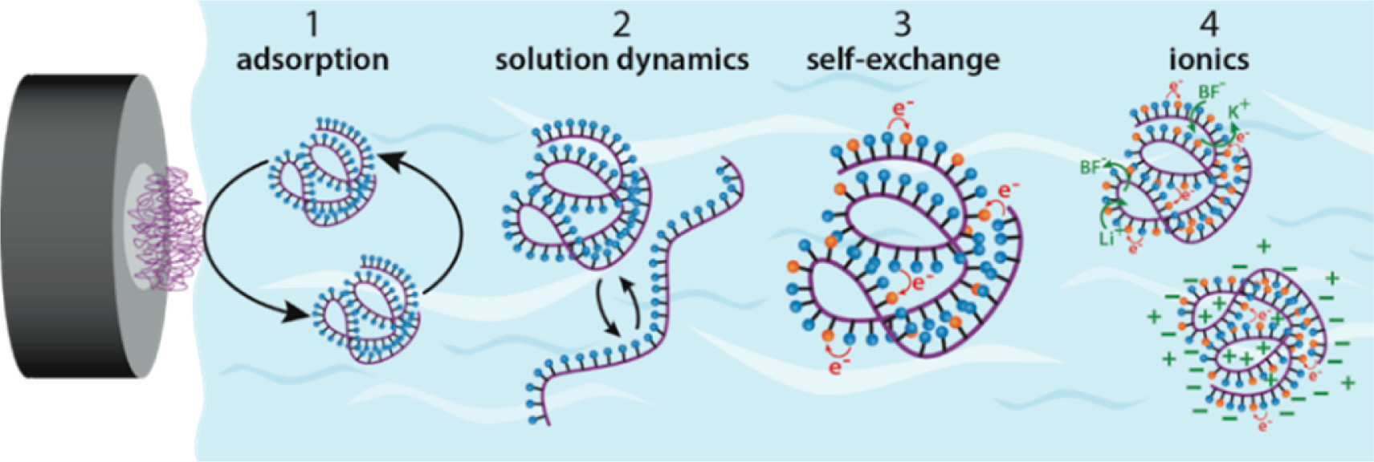
Redox-Active Pendant Bearing Polymers
Outline Introduction Results and Discussion Summary
Redox-active pendants
The backbone of the polymer is not conductive.
However, there are lots of redox-active functional groups that can be attached (grafted) to the backbone.
Each pendant group can be individually oxidized or reduced.
Synthesis pathways for these polymers are mostly well-defined.
The behavior of redox-active pendant bearing polymers is highly dependent on:
Solution environment
Molecular structure
Molecular weight
Non-conductive backbone
Accounts of Chemical Research 2016, 49 (11), 2649–2657
10

Slide 12
Redox-Active Pendant Bearing Polymers: The Significance
Outline Introduction Results and Discussion Summary
The possibility of accepting/donating multiple electrons within a single polymer molecule gives rise to an enhanced energy density.
Theoretically, the capacity of the battery is only limited by (1) the allowable number of redox-active pendants on the polymer backbone (2) the solubility limit of the redox-active polymer
Fairly straightforward and cheap synthesis
However, the behavior of different redox-active pendant bearing polymers is very complicated inside different solutions. A more systematic understanding is still required for commercialization.
11

Slide 13
Summary
Outline Introduction Results and Discussion Summary
Traditional inorganic electrolyte-based redox-flow batteries have energy density and cost problems.
Redox-active polymers are attractive solutions to the forementioned problems.
Redox-active group embedded polymers (conductive polymers) allows a much higher energy density, as it allows charges to be stored in a solid-state medium instead of liquid-state.
Redox-active pendant bearing polymers also allows a higher energy density due to the presence of multiple redox-active groups in one polymer molecule and is closer to be commercialized.
In general, more research is required in the field of redox-active polymers.
Thanks! Any Questions?
12

